Slide 1


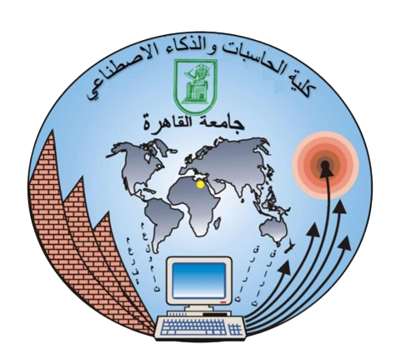
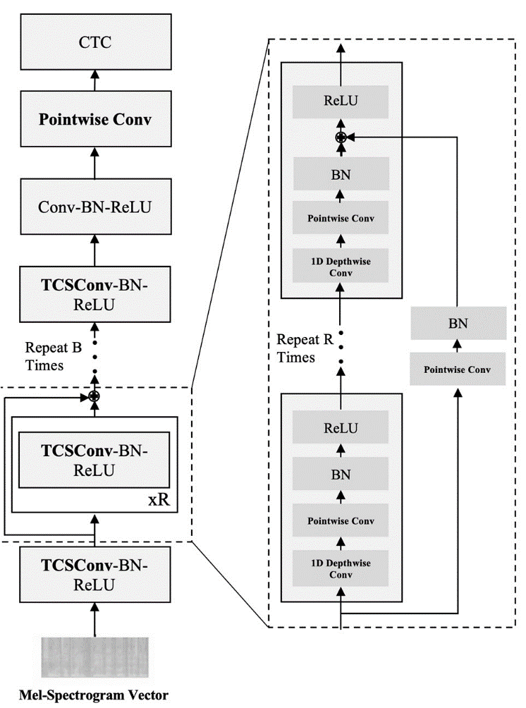
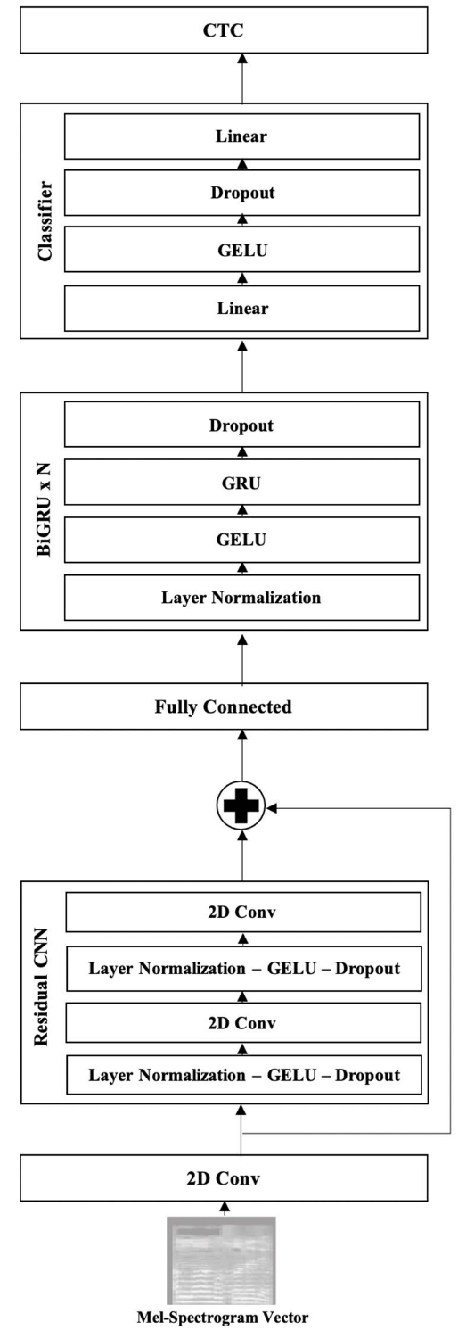











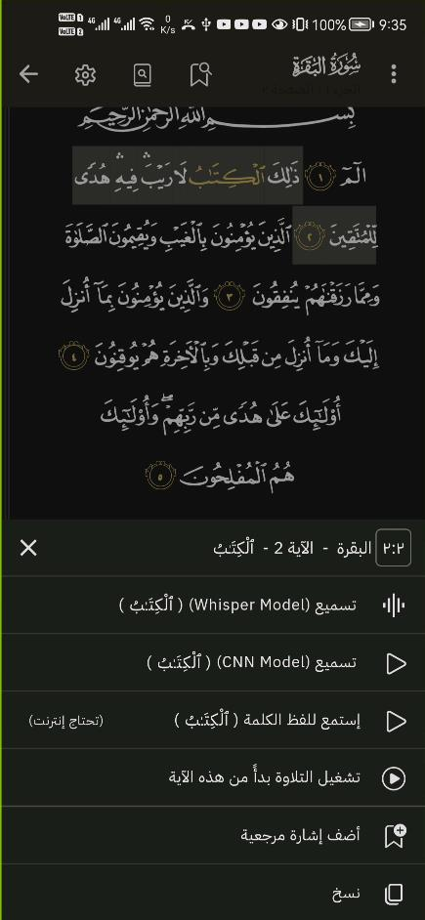
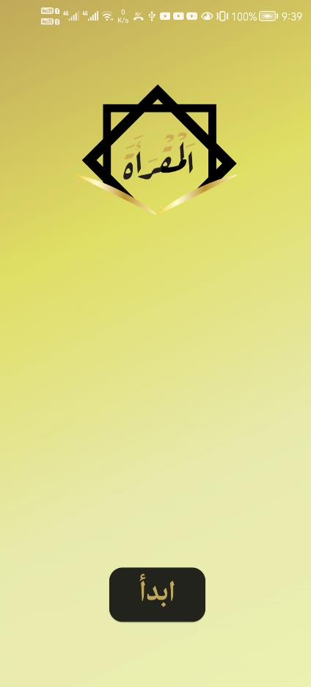
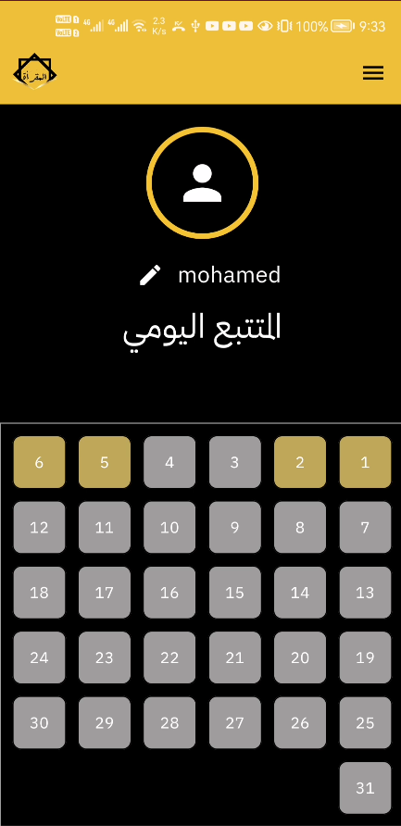
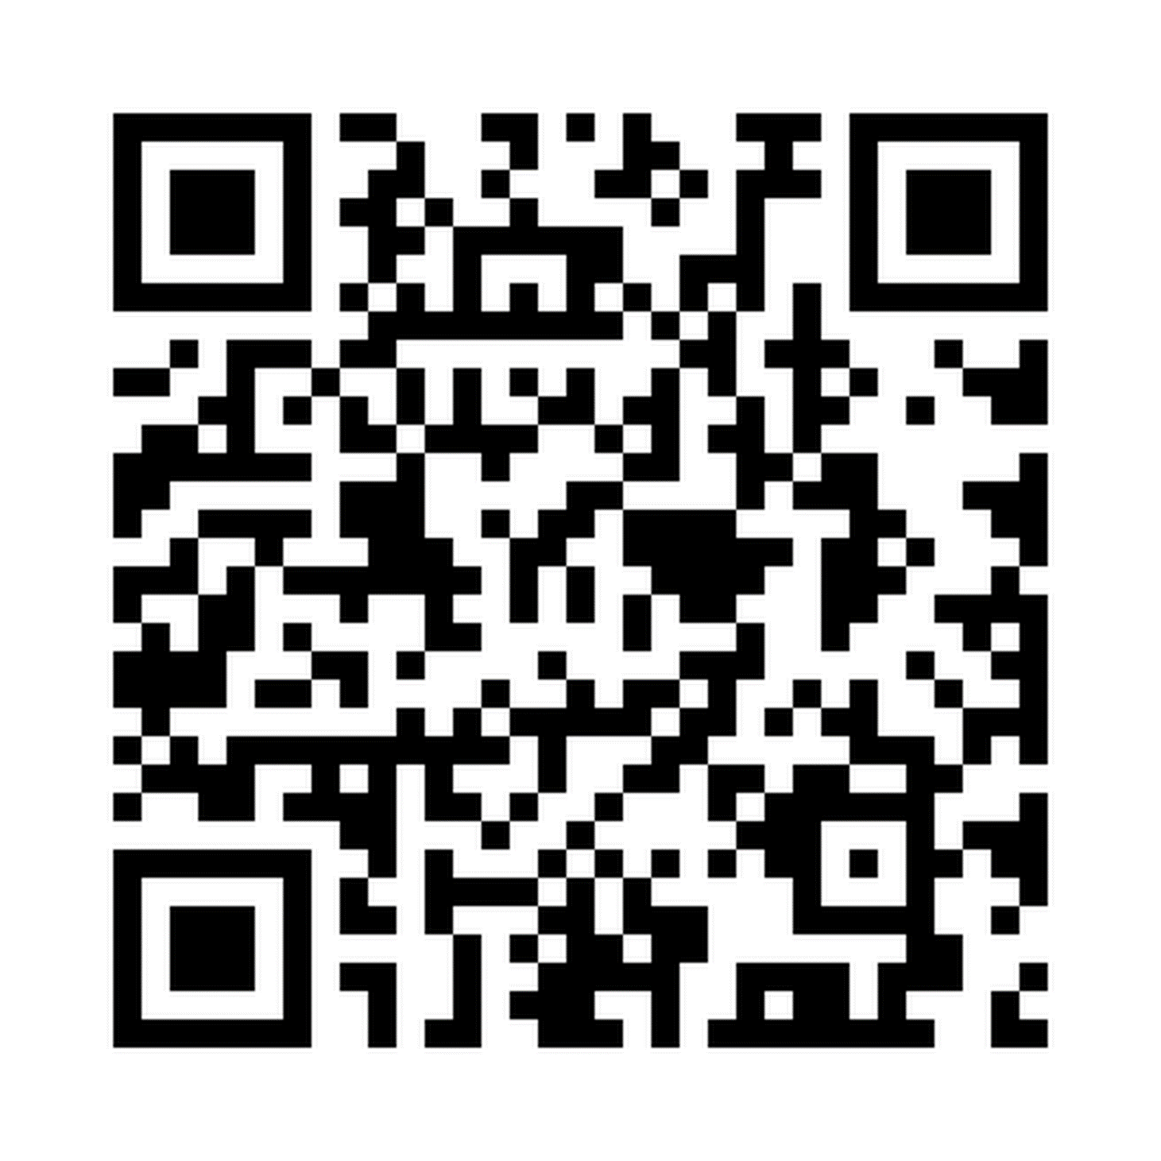
Supervisor(s): Dr. Hanaa Bayomi , TA. Amany Hesham
Team members:
Ahmed Sallam, Farah Tawfik , Mohamed Gamal , Mohamed Gaber , Omar Walid
VISION / OBJECTIVES
METHODOLOGY
We aim to provide accessible, flexible, and accurate Quran recitation and memorization tools for Muslims worldwide.
Develop mobile application, to offer real-time feedback on pronunciation and memorization, enhancing the learning experience regardless of geographical and time constraints
Iterative Waterfall Methodology.
We used two Speech Recognition Models :
Implemented using CNN–CTC & RNN-CTC the both models focus on convert Arabic speech to Arabic diacritics text.
BENEFICIARIES
Muslims Worldwide Who want to memorize and recite Holy Quran
USED TECHNOLOGIES
DELIVERABLES / OUTPUT
Mobile Application to help users with Quran recitation and memorization.

